Slide 1
T-infinity: The Dependency Inversion Principle for Rapid and Sustainable Multidisciplinary Software Development
Matthew D. O’Connell, Cameron T. Druyor, Kyle B. Thompson, Kevin E. Jacobson,
W. Kyle Anderson, Eric J. Nielsen, Jan-Reneé Carlson, Michael A. Park, William T. Jones,
Robert T. Biedron, and Bil Kleb NASA Langley Research Center
Xinyu Zhang
Analytical Mechanics Associates, Inc.

Slide 2
CFD 2030 Vision Report
“NASA should develop and maintain an integrated simulation and software development infrastructure to enable rapid CFD technology maturation.” - CFD 2030 Vision Report Programmatic Recommendation #2
We are attempting to guide new software development efforts and add benefits to existing software tools keeping this recommendation in mind.

Slide 3
Motivation
Software should scale!
Scale with computer resources. (Parallel Scalability)
Scale with human resources. (Human Scalability)
Challenges:
Problems are so complex, no one can be an expert in every aspect.
Experts solving problems from a different domain of expertise is suboptimal.
Has someone else solved this software complexity problem?
Notes:
Many advanced technologies exist, but are often not fully integrated.
Complex engineering challenges lead to complex solutions, and often complex software code bases.
Engineers, scientists, and programmers can’t be an expert in every aspect of the problem space.
To solve ever challenging problems we need experts to focus on their part of the problem that is within their expertise.
Whenever possible experts need to be able to ignore details from experts in other disciplines.
Our analysis and design software should enable, not inhibit, expert-scalability.

Slide 4
Borrow from Software Engineering
Dependency Inversion Principle
High-level modules should not depend on low-level modules. Both should depend on abstractions.
Abstractions should not depend on details. Details should depend on abstractions.
SOLID Design Principles
Single Responsibility Principle
Software entities should have only one reason to change.
Open Closed Principle
Software entities should be open for extension, but closed for modification.
Liskov Substitution Principle
Subtypes must be substitutable for their base types.
Interface Segregation Principle
Clients should not be forced to depend on methods that they do not use.
Dependency Inversion Principle

Slide 5
Borrow from Software Engineering
Dependency Inversion Principle
High-level modules should not depend on low-level modules. Both should depend on abstractions.
Abstractions should not depend on details. Details should depend on abstractions.

Slide 6
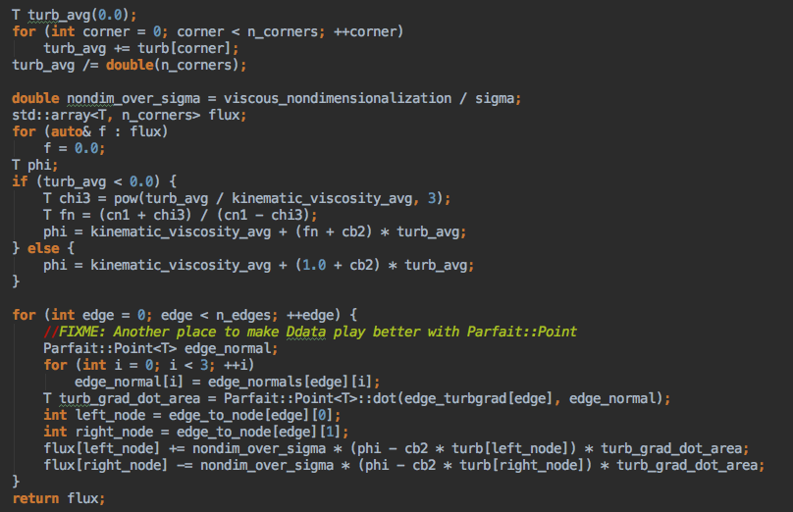
Direct Coupling
High level concept
Dependency
Low level detail
CFD Solver
A specific turbulence model
No!
Causes tight coupling,
hard to maintain,
high cognitive load.

Slide 7
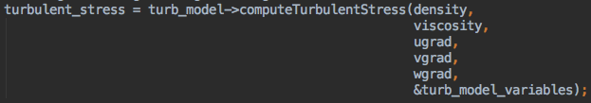
Dependency Inversion
High level concept
Dependency
CFD Solver
Needs a
Stress Tensor Closure
Abstraction
Implements
Can Give
Low level detail
A specific turbulence model
Yes!
Forces modularity,
easy to extend,
lower cognitive load

Slide 8
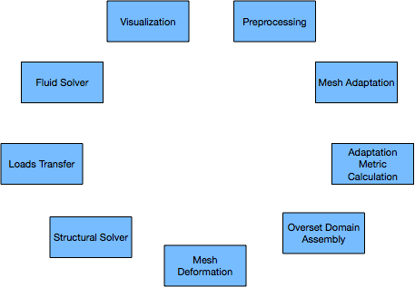
Abstractions

Slide 9
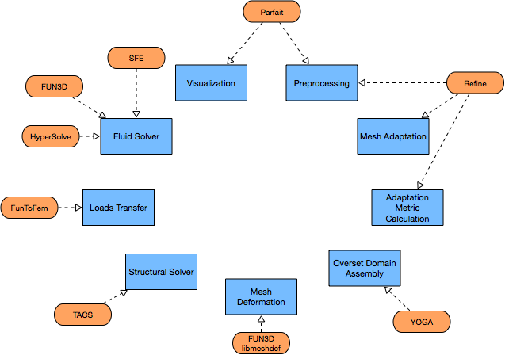
Plugins Implement Abstractions

Slide 10
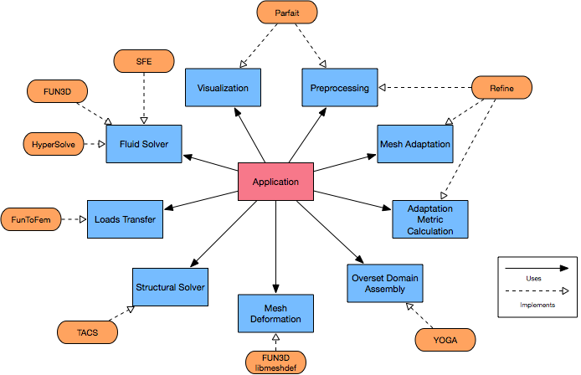
Applications Use Abstractions

Slide 11
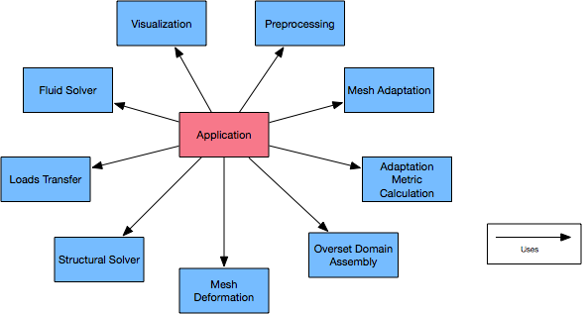
Applications Don’t “Know” About Plugins

Slide 12

T-infinity is Only Abstractions

Slide 13
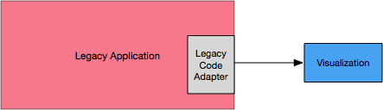
Flexible Uses: Adapt Existing Data Structures
Legacy applications can adapt existing data structures to leverage desired features.
T-infinity interfaces are not a framework.

Slide 14
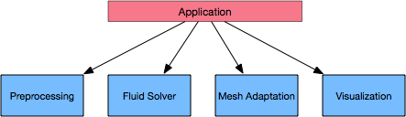
Flexible Uses: Cohesive Orchestrating Applications
The interfaces are designed to be independent, yet collaborative.
The output of one interface is the input of another.
Orchestrating applications can be written without adapting data.

Slide 15
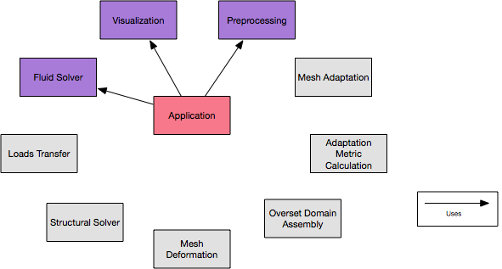
Simple Application: Steady State CFD

Slide 16
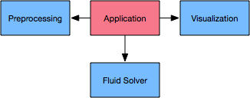
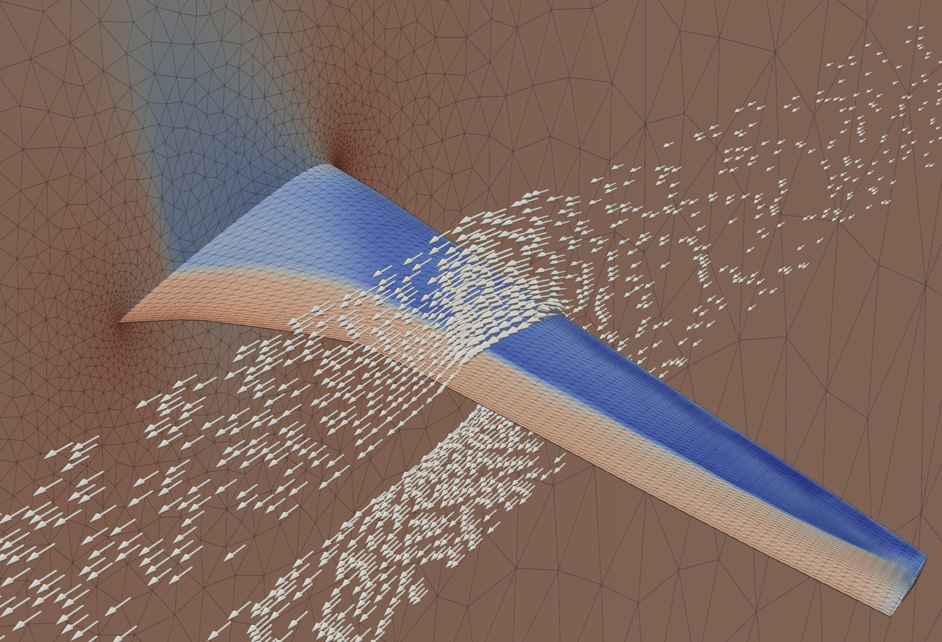
Simple Application: Steady State CFD
Inviscid Analysis
Fluid Solver: FUN3D
Visualization & Preprocessing: Parfait

Slide 17
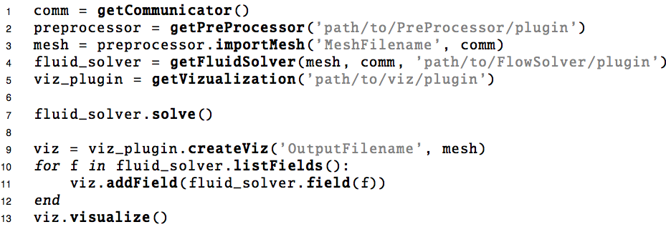
Simple Application: Steady State CFD

Slide 18
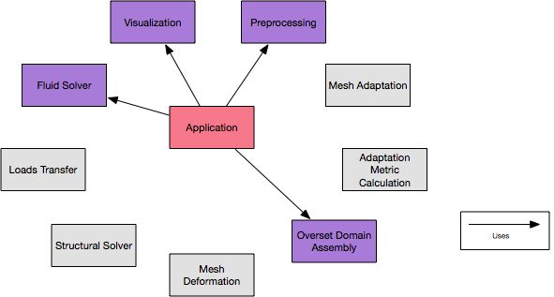
Pick and choose: Overset

Slide 19
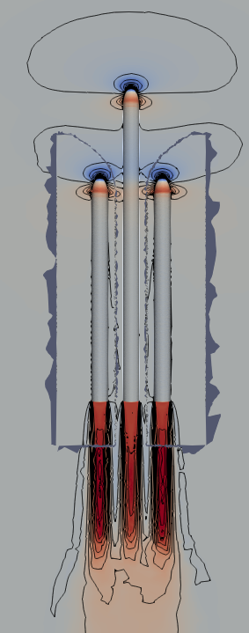
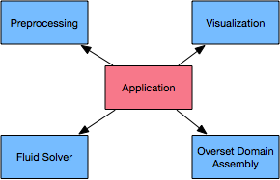
Pick and choose: Overset
Two domain overset:
Fluid Solver: HyperSolve (Prototype Finite Volume)
Domain Assembler: YOGA
Visualization & Preprocessing: Parfait

Slide 20
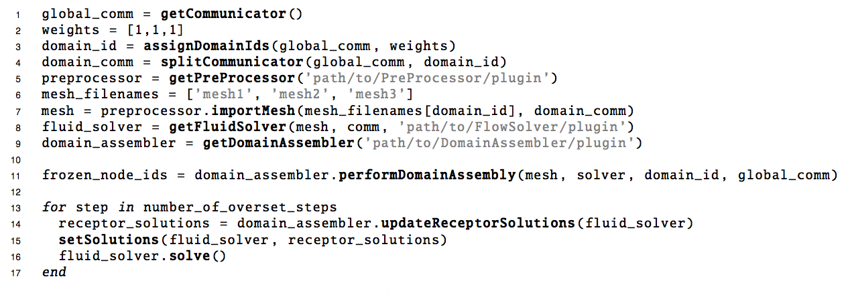
Pick and choose: Overset

Slide 21
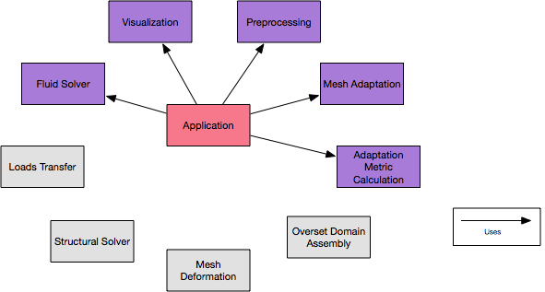
Pick and choose: Mesh Adaptation

Slide 22
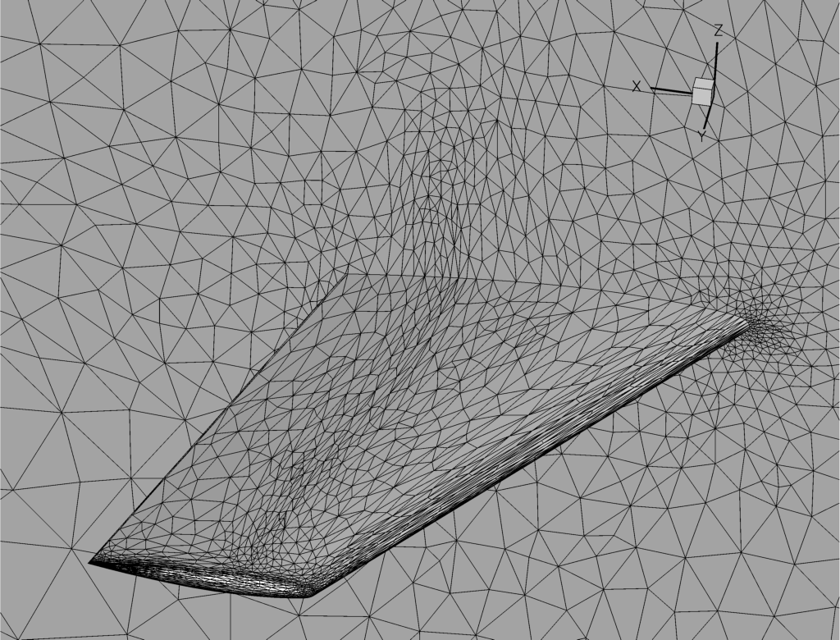
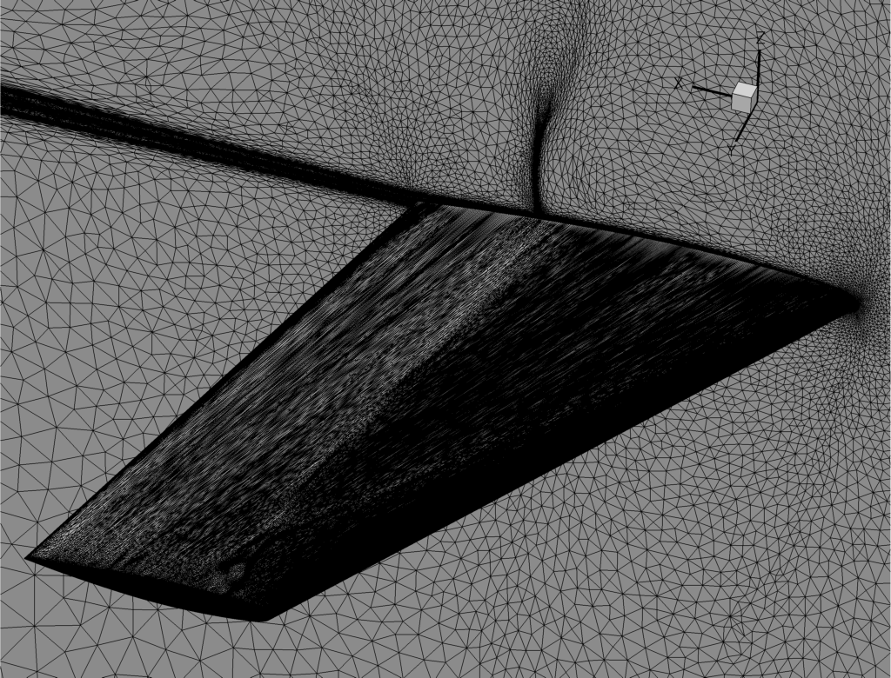
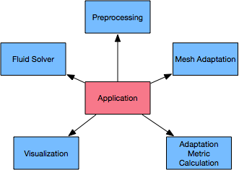
Pick and choose: Mesh Adaptation
Mach Hessian to metric based adaptation.
Solver: SFE
Adaptation, Visualization, Preprocessing: Refine
Access to CAD via EGADS lite.

Slide 23
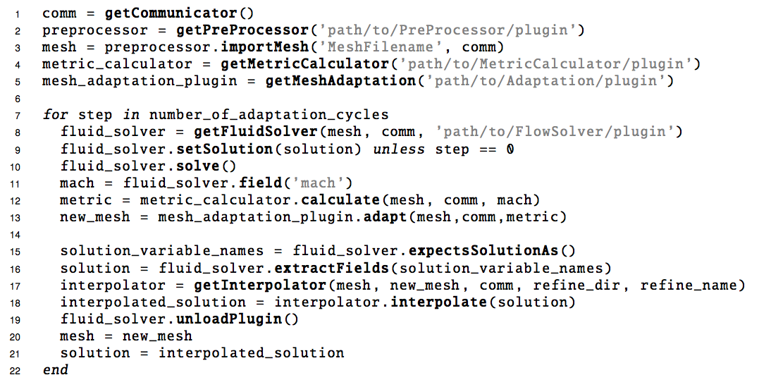
Pick and choose: Mesh Adaptation

Slide 24
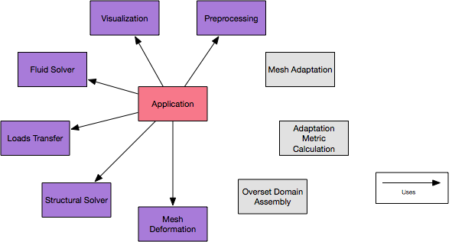
Pick and choose: Fluid Structures Interaction

Slide 25
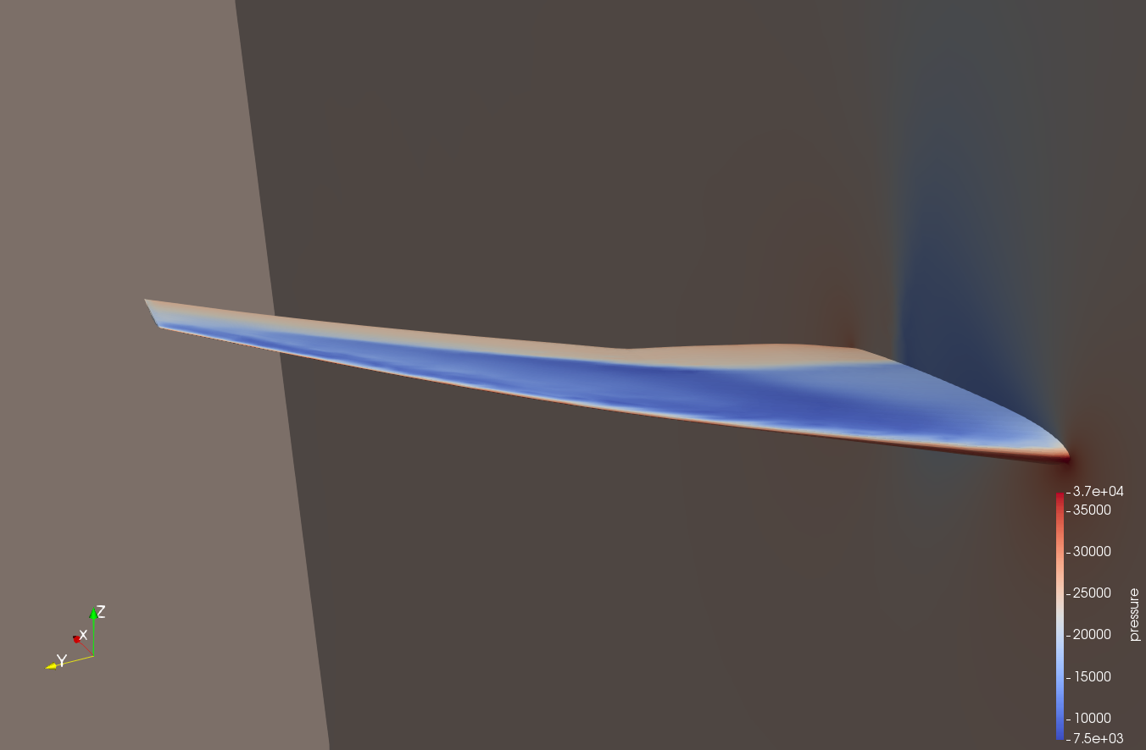
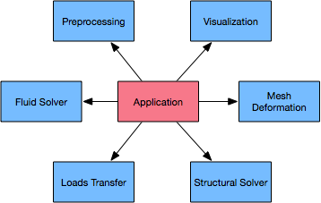
Pick and choose: Fluid Structures Interaction
Static structural deflection
Solver: HyperSolve
Loads Transfer: FunToFem
Structural Solver: TACS
Volume mesh deformed: FUN3D libMeshDef
Visualization & Preprocessing: Parfait

Slide 26
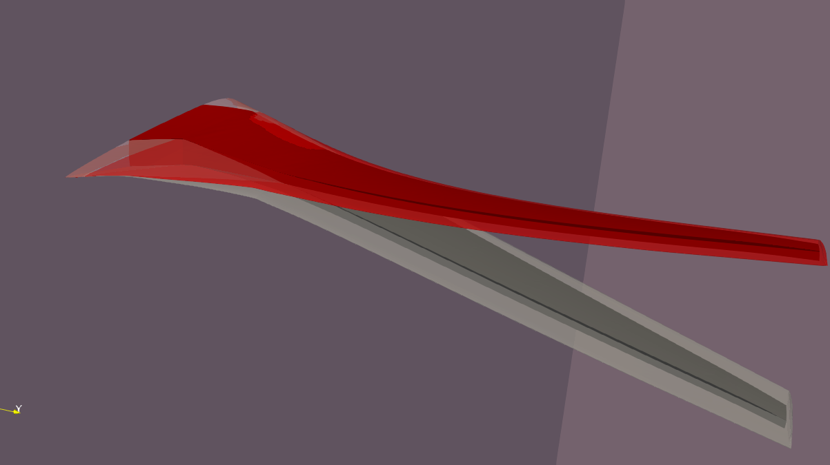
Pick and choose: Fluid Structures Interaction
Static structural deflection
Solver: HyperSolve
Loads Transfer: FunToFem
Structural Solver: TACS
Volume mesh deformed: FUN3D libMeshDef
Visualization & Preprocessing: Parfait

Slide 27
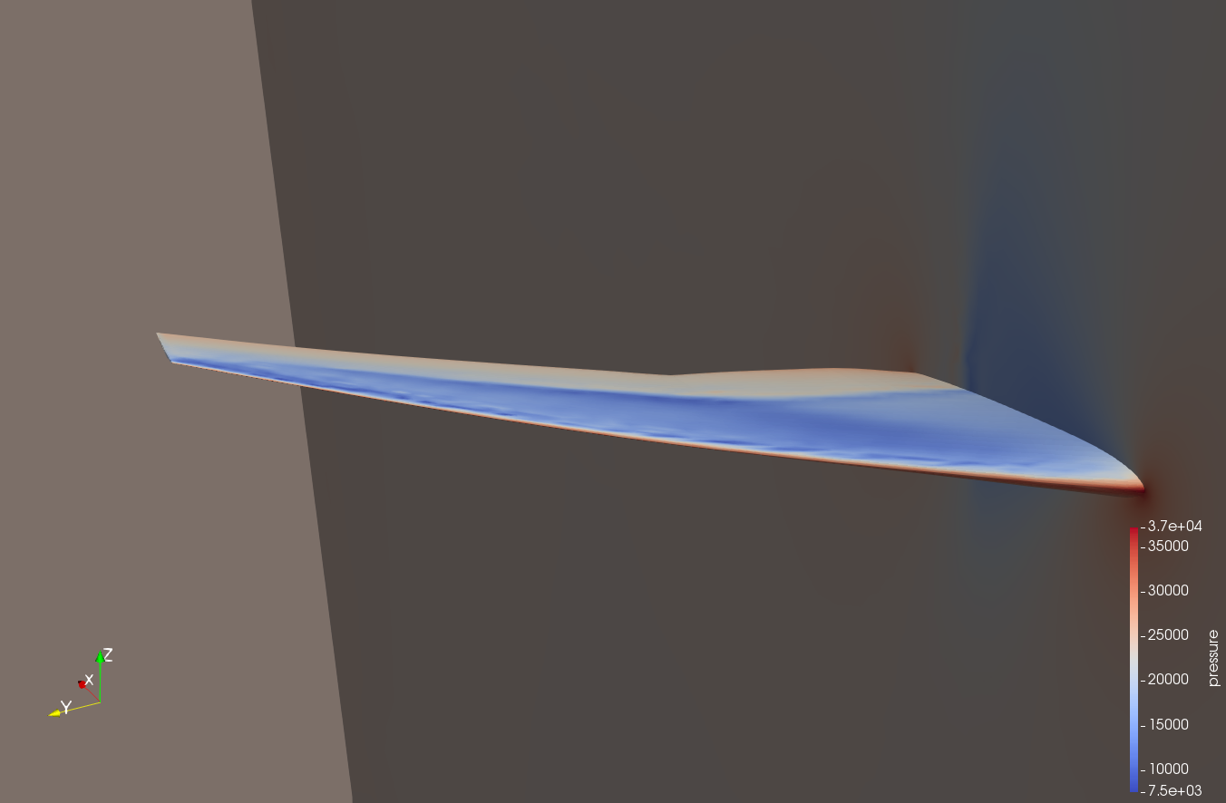
Pick and choose: Fluid Structures Interaction
Static structural deflection
Solver: SFE
Loads Transfer: FunToFem
Structural Solver: TACS
Volume mesh deformed: FUN3D libMeshDef
Visualization & Preprocessing: Parfait

Slide 28
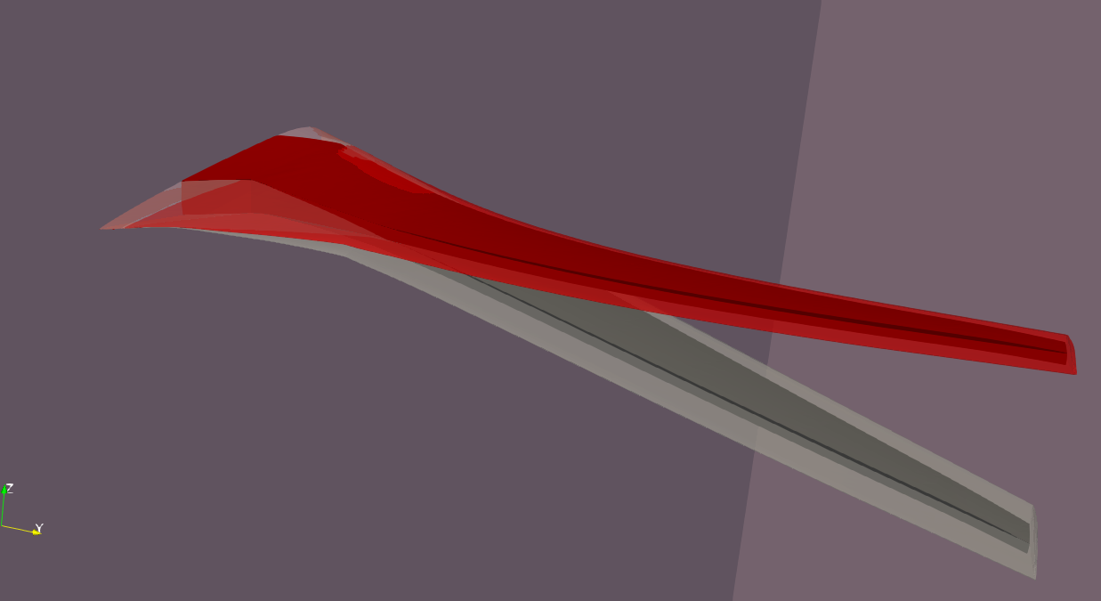
Pick and choose: Fluid Structures Interaction
Static structural deflection
Solver: SFE
Loads Transfer: FunToFem
Structural Solver: TACS
Volume mesh deformed: FUN3D libMeshDef
Visualization & Preprocessing: Parfait

Slide 29
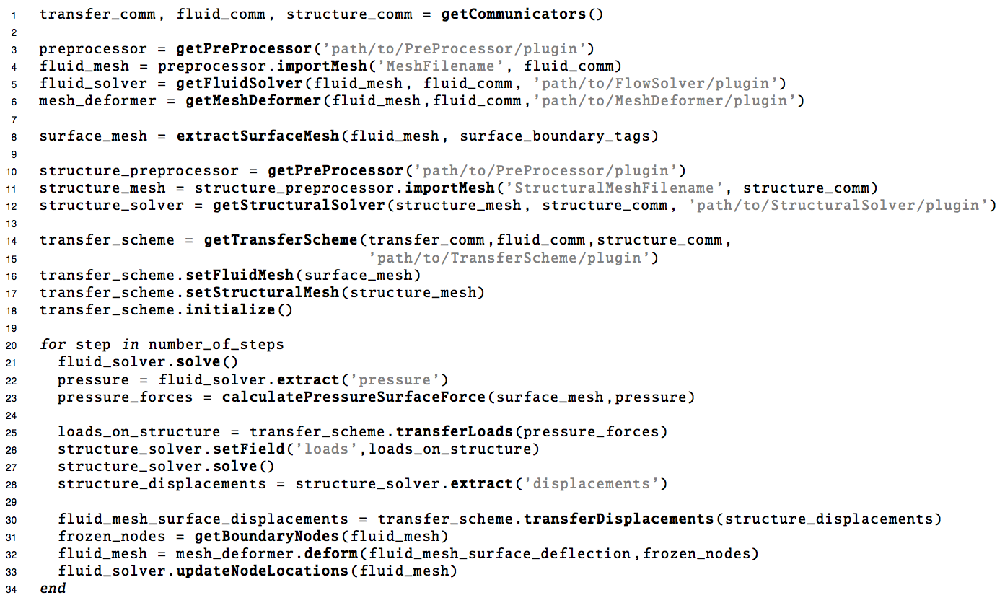
Pick and choose: Fluid Structures Interaction

Slide 30
Summary of Current Status
Finalizing Interfaces for solving steady state problems on vertex based unstructured grids.
Reference plugin implementations exist for:
Mesh Pre-processing
Mesh Adaptation
Multiscale Metric Calculation
Loads Transfer
Fluid Solver
Structural Solver
Overset Domain Assembler
Mesh To Mesh Interpolation
Mesh Deformation
Visualization
A plugin adapter is being written for FUN3D and VULCAN.
Interfaces and reference implementations for cell centered unstructured meshes are still under construction.

Slide 31
Thank you!
Revolutionary Computational Aerosciences and Hypersonics Technology Project for funding this effort.
And to those who have shared feedback!

Slide 32
Backup

Slide 33
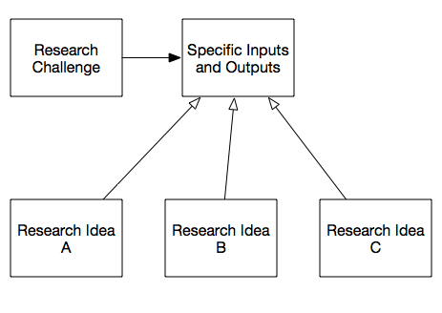
Dependency Inversion for Research
There is a clear separation from application developers using an interface, and research teams looking to implement it.
Independent research teams can work on their own implementation, but by following the set interface they can all be interchanged for comparison.
Technology improvements can be developed and tested in isolation without worrying about the complexity of the software that surrounds it.
When the time comes, it is trivial to integrate that new technology into a larger body of work.

